Slide 1
Diversity Inquiry
Name:
Tutor:
Course:
Date:

Slide 2
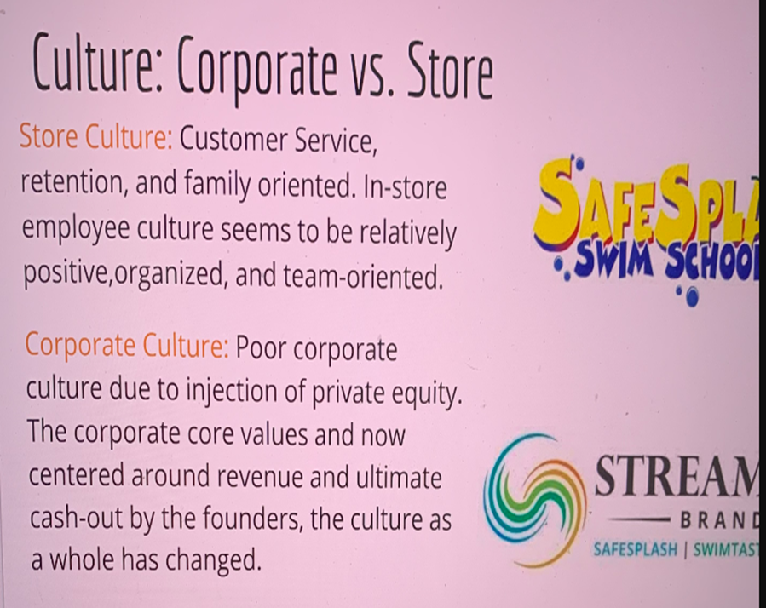
Diversity at SafeSplash
The CEO is determined to get the customers close.
Deep understanding of the customers.
Focused to build strong long-lasting relations (Matt 2).
Building strong brand reputation.
Believes in diversity at place of work
Notes:
The CEO is determined to get the customers as close as possible. Once the customers have been close enough, the CEO and other workers will be able to offer the services that are required by the customers. Through such a relationship, the company will be able to build on a long lasting reputation

Slide 3
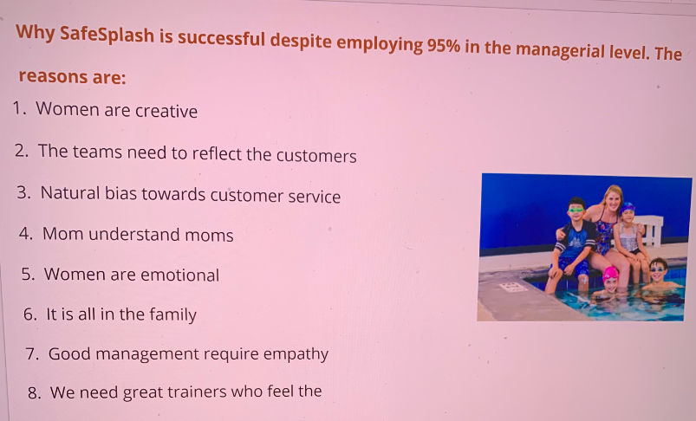
Diversity at SafeSplash
The company is dominated by women.
95% of the managers are women (Matt 1).
The team reflects the customer.
Offers amazing customer services.
The company realizes creativity
Notes:
The company’s managerial positions are almost all held by women – 95% are held by women. However, this is the kind of diversity that makes the company to be a leader within the industry of operation. women are well though to create a team that reflects on the customers. Women are also creative and this industry needs a high level of creativity. Thus, women are the ones who are behind the success of the company.

Slide 4
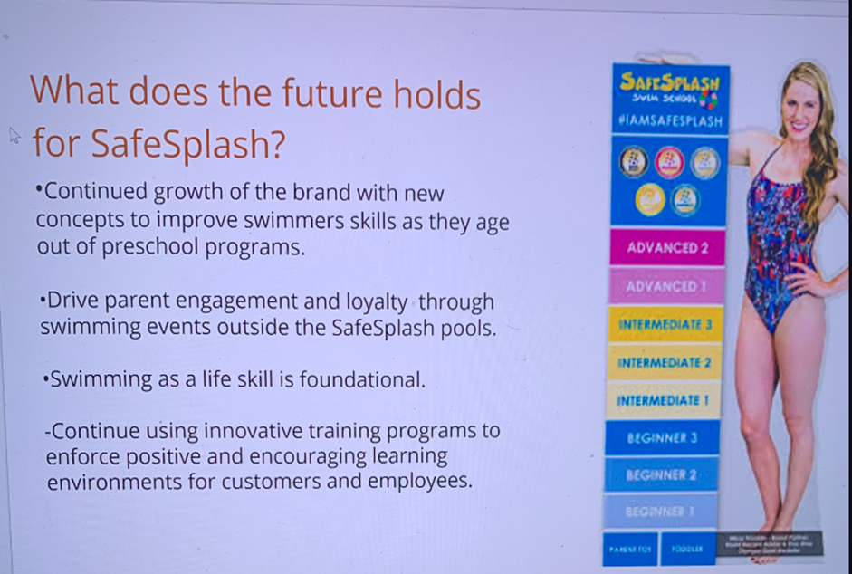
The Future of SafeSplash
Looking for new concepts to foster swimming skills.
Organization of events that will create engagement as well as loyalty.
Viewing swimming as a fundamental life skill.
Fostering innovative training program (Matt 2).
Notes:
The company’s CEO is always looking for ways through which he can create new concepts to enhance customer’s swimming skills. The company has in place events that engages the parents and hence making them to be loyal customers. The company is also being innovative and thus will keep on capturing the attention of the customers from its innovative products and services.

Slide 5
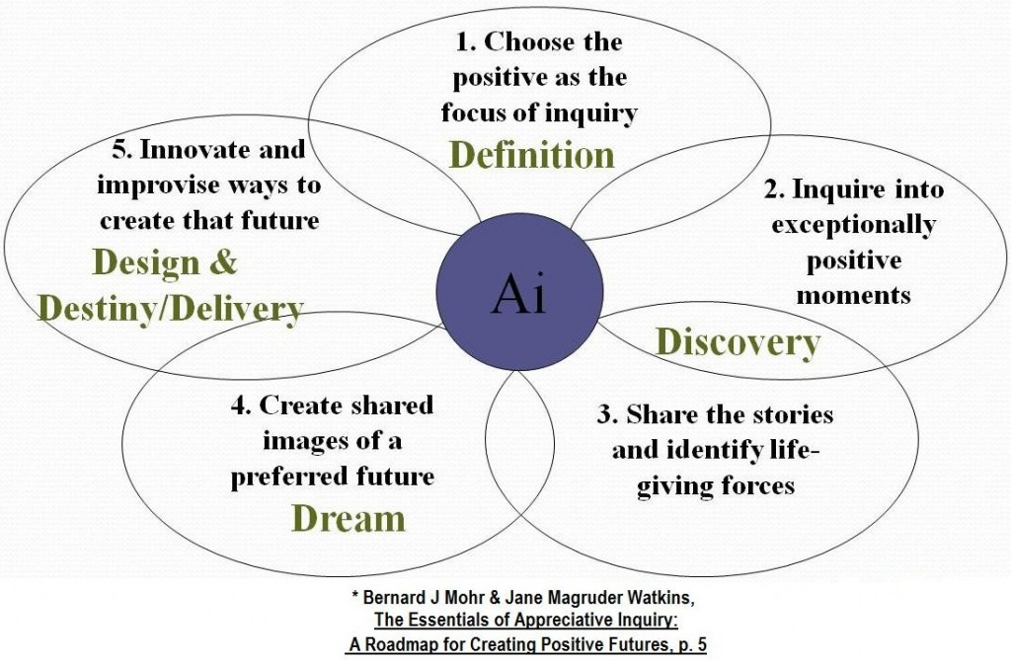
Appreciative Inquiry
The company has a kind of diversity mix that makes it successful.
The company has created new concepts that have enhanced swimmers’ skills.
The company has creative programs that help in engaging all stakeholders.
The franchising business seem to be successful.
Notes:
The company has a set of activities that engages the parents and makes them to be loyal. It has also incorporated creativity in its business thus making it to be attractive.

Slide 6
Work Cited
Matt, Lane. "8 Reasons Our Manaement Team is Dominated by Women." SafeSplash Swim School (2016): https://www.safesplash.com/employmentblog/8-reasons-our-management-team-is-dominated-by-women.

